Slide 1
DIGITAL
Literacy

Slide 2

Digital Literacy
Digital Literacy is the ability to resposibly and effectively use digital Technologies- like computers,smartphones, and the internet-to find,evaluate, create , and communicate information.

Slide 3
Key Components of Digital Literacy
Information Literacy
Technical Skills
Communication Skills
Digital Safety(Cyber Awareness)
Content Creation

Slide 4




Some Useful Digital Tools
Note-Taking & Organization Tools :- Evernote, Microsoft OneNote, Google Keep
Study & Revision Tools :- Quizlet, Kahoot
Writing & Grammar Tools:- Grammarly
Research & Learning Platforms:- Google Scholar , Google Classroom
Creative & Presentation Tools:-Canva, Microsoft Powerpoint

Slide 5
Some safe Internet practices
Use Strong Passwords
Create passwords with letters, numbers, and symbols
Avoid common words like “123456” or your name
Use different passwords for different accounts
Consider using a password manager (like LastPass or Bitwarden)

Slide 6
Some safe Internet practices
Enable Two-Factor Authentication (2FA)
Adds an extra layer of security
Even if someone knows your password, they can't log in without a second code
Apps like Google Authenticator help generate secure codes

Slide 7
Some safe Internet practices
Beware of Phishing Scams
Don’t click suspicious links in emails or messages
Check sender details carefully
Never share OTPs, passwords, or bank details

Slide 8
Some safe Internet practices
Install Antivirus Software
Helps detect and remove malware
Examples: Quick Heal Antivirus, Avast Antivirus

Slide 9
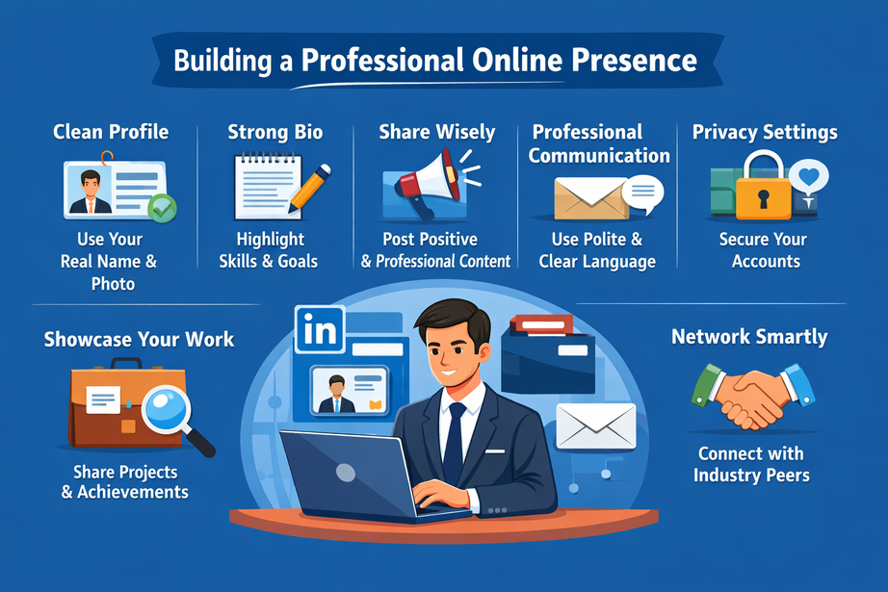
Professional Online Presence
A professional online presence means how you present yourself on the internet in a way that builds trust, credibility, and positive reputation—especially for studies, jobs, or business.

Slide 10
Key Elements of a Professional Online Presence
1. 👤 Clean & Professional Profiles
2. 📝 Strong Bio and Information
3. 📸 Appropriate Content
4. 💬 Professional Communication
5. 📂 Showcase Your Work
6. 🔍 Manage Your Digital Footprint

Slide 11
Thank You

